Slide 1
Company Sales Performance Overview
Presented By
Praveen

Slide 2
introduction
Good day, CEO and CMO. I am here to present our company's sales performance for the years 2010 and 2011.
Thank you for giving me the opportunity to analyze the data and provide insightful information about the store's performance.
Your questions have provided a general direction for the kind of insights you are looking to get from this analysis.

Slide 3
Thought Process
I assure you that I took all the necessary steps to ensure that this analysis is accurate and correct.
As a consultant, I have reviewed the data and provided valuable insights that would be useful for the CEO and CMO to understand how the business is performing and what areas are the key strengths of the company.
I cleaned up the data you provided by removing all the negative values in the Unit Price and Quantity columns and also filtered the data as required for all the visualizations.
I have used Power BI, a business intelligence tool, to create a Tata Online Retail Dashboard that provides a comprehensive view of the store's performance.

Slide 4

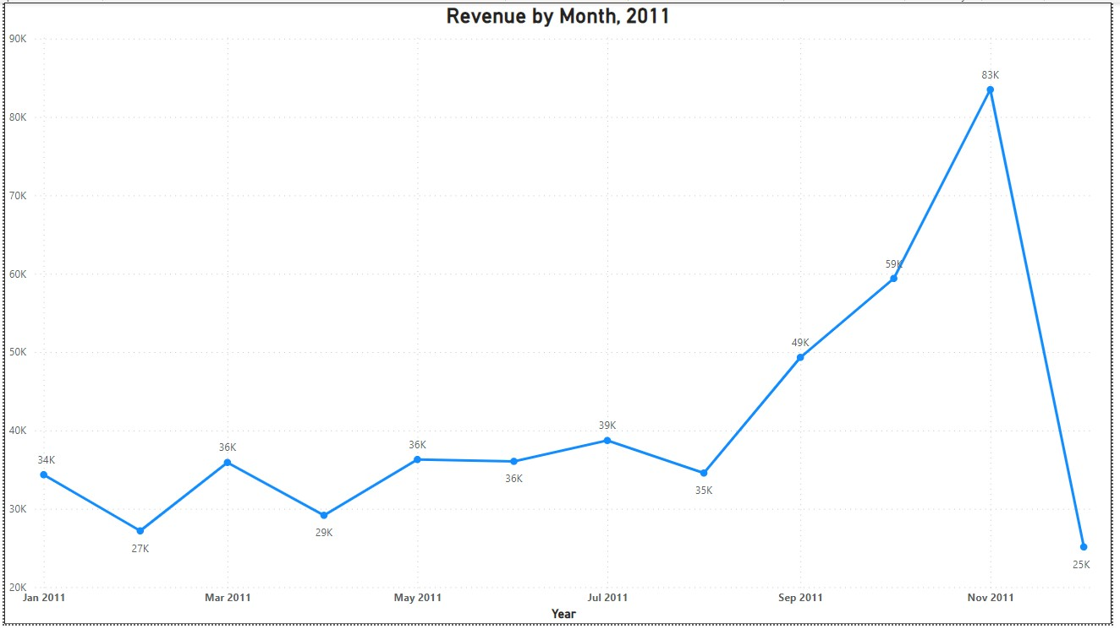
Revenue by month, 2011
The first 8 months have stable monthly revenue with an average of $34,000
We had a significant increase in revenue from September with the revenue peaking at $83K in November
The revenue trend from August to December demonstrate how seasonality affects retail store sales.

Slide 5
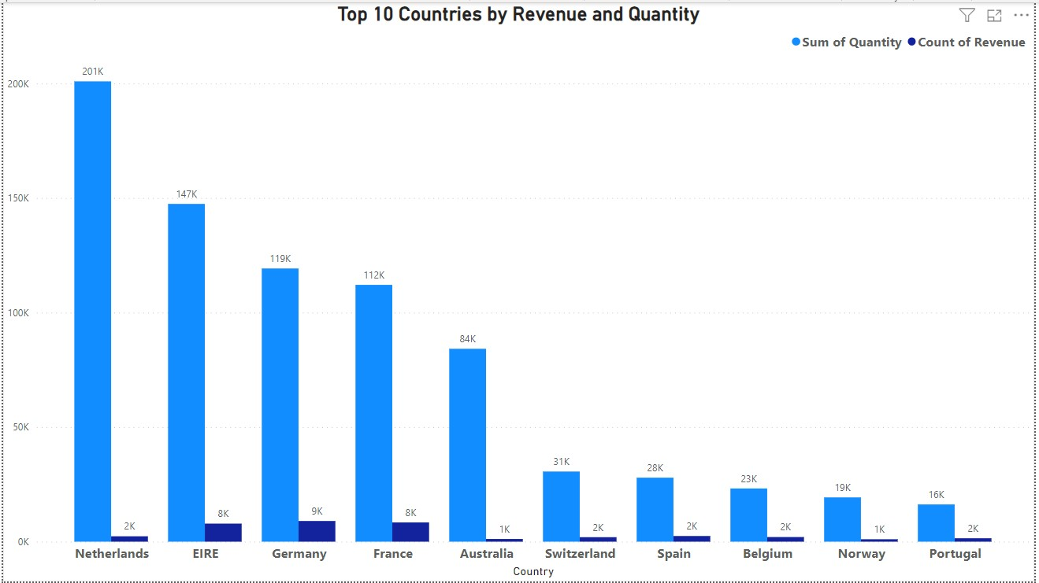
Top 10 Countries by Revenue and their Quantity
This chart represent the top 10 countries in revenue and the quantities bought in these countries except the United Kingdom.
These countries represent regions with the highest potential to generate more revenue that management needs to focus more on in terms of marketing strategies.

Slide 6
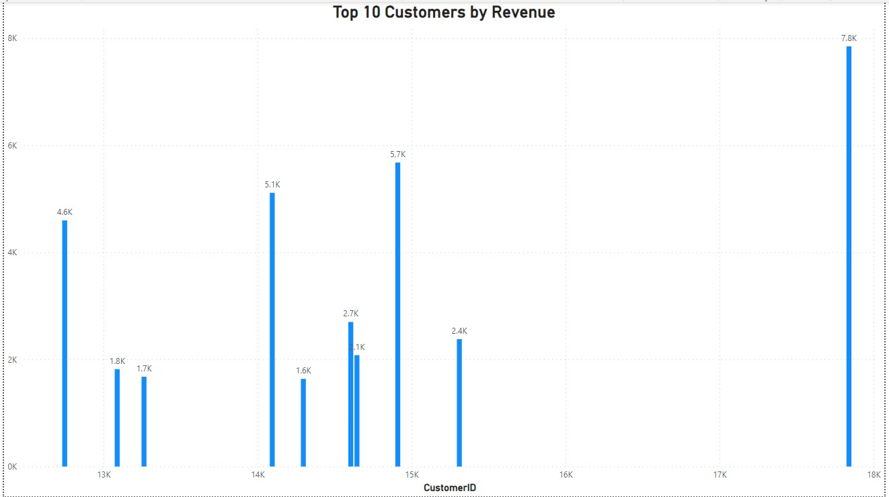
Top 10 Customers by Revenue
The chart shows that there is no major difference between the top 10 customers in terms of revenue generated.
The average difference in revenue between the top 10 customers is 3.55%.
The company can aim to strength the relationship with these customers to increase loyalty, retention, and ultimately drive more sales and revenue for the company.

Slide 7
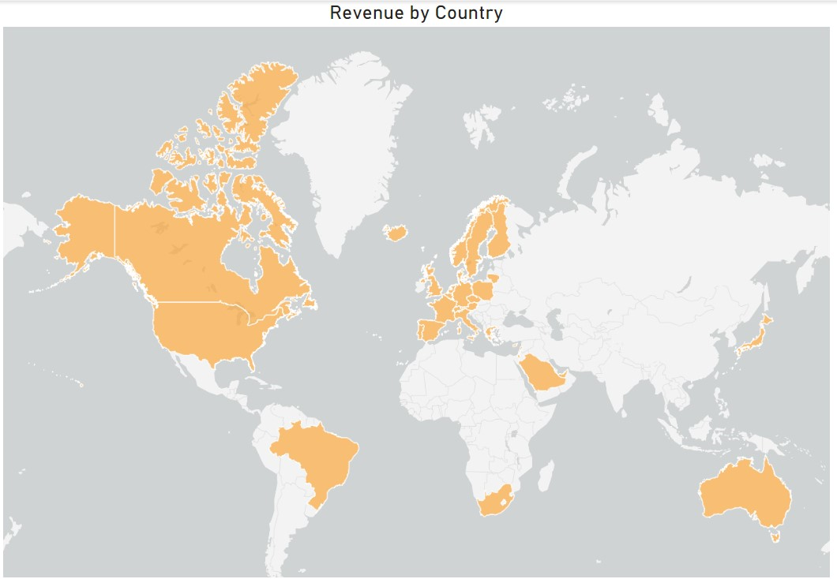
Revenue by Country
The map chart conclude by comparing the place that have the greatest revenue to those that have not.
The map also reveals that the majority of sales occur only in the European Zone, with only small numbers in the American region.
Along with Russia, there is no market for the item in Africa and Asia.
The company can concentrate on the European market more and dive deeper into countries in the region to come up with strategies that will maximize sales from each region alongside Australia and Japan.

